Slide 1
Section 10.2 Using
T-Distribution to Estimate a Population Mean

Slide 2
Review: If we want a 94% confidence interval, which of the following will give us the correct Z-critical value?
a) invNorm(0.94) b) invNorm(0.06) c) invNorm(3)
d) invNorm(0.03) e) invNorm(94,0,1)
1. Remember that a 94% confidence, means that the tail area will be 3%
2. Inverse Norm the tail area to get the Z* score
In this case, it would be: “C” invNorm(0.03)
Review: Suppose we have a 95% confidence interval with a standard error of 1.5. What does the sample size need to be if we want the margin of error to be less than 0.04?

Slide 3
REVIEW: Conditions for Constructing a Confidence Interval:
There are 3 conditions that must be met in order to construct a confidence interval
(SRS) The data must come from a Random Sample or Randomized experiment
(Normal)The sampling distribution of the statistic must be approximately Normal (Which means that the population is either Normal or the sample size is equal or greater than 30)
(Independence) The individual observations must be independent (Which means the 10% condition if we are sampling without replacement from a finite population)
IT is IMPORTANT that you write out that each of these conditions are met when constructing a confidence interval
Goal: Create a “narrow” interval that we are confident will capture the desired parameter (Population mean or proportion)

Slide 4
What’s Important? “T” INTERVALS
In this section, we will create a confidence interval to estimate the population mean µ when the population standard deviation “σ” is unknown , not given to us
In 10.1, we are given “σ” to determine the standard error:
In 10.2, instead of using σ we will use “s”, which is the sample standard deviation:
So if σ is unknown, we can’t use a normal distribution to create our confidence interval.
Instead, we use a “t-distribution”
‘s”: Sample Standard deviation
Confidence Interval =
the “t*” value will depend on TWO things: confidence level and “degrees of freedom”
The “degrees of freedom” is equal to the sample size minus one
The “t*” critical value is the number of standard errors you want in your margin of error

Slide 5
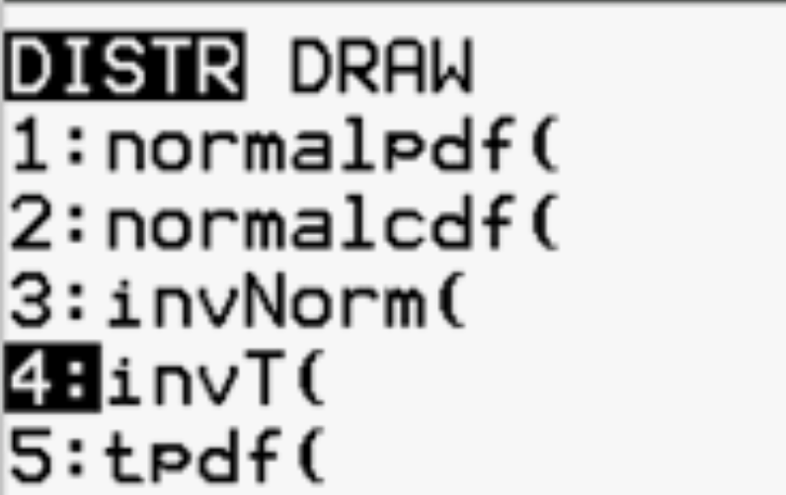
Using Ti83 To find the T* (critical “T” Value)
Newer Graphing calculators have InvT(left area, df)
If your graphing calculator does not have invT
(ie: older ti-83),create a program to do invT for you!
https://youtu.be/5Ft5eZVJtPk
To find the t* critical value, you need TWO things:
  1. Left area from the level of confidence
  Ie: a confidence of 95% will have a left area of 0.025 OR 0.975
  2. Degrees of freedom (df) = this is your sample size “n” minus 1
You can also use “table-C” (the t-distribution table) to get “t*”
  Uses the DF and confidence level to determine t*
  Con: Don’t have values for every degrees of freedom – use the next smallest one

Slide 6
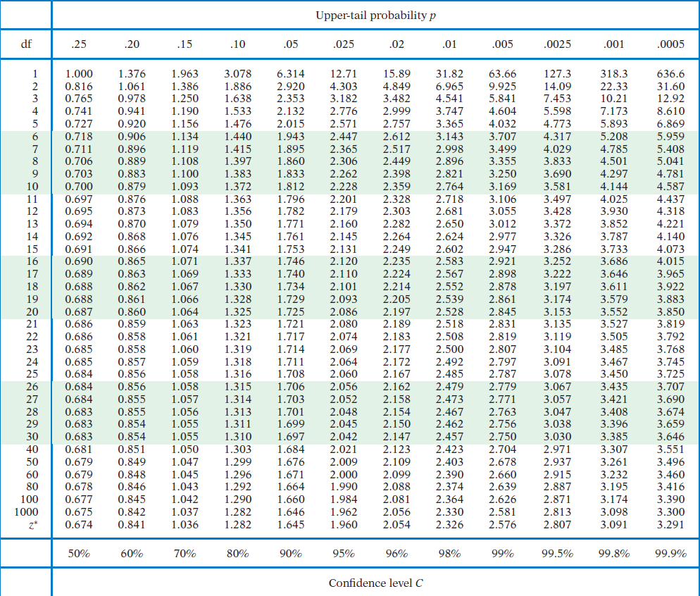

Slide 7
Ex: Use table C to find the t*-critical values for each sample size “n” and confidence level. Indicate the “degrees of freedom” and then use your Ti 83/84 to find t*
i) n=5, CL=90%
ii) n=45, CL=95%
iii) n=90, CL = 99%
Left Area = 5%
Left Area = 2.5%
Use df of “40” if you are
using the chart
Left Area = 0.5%
Use df of “80” if you are using
the chart

Slide 8
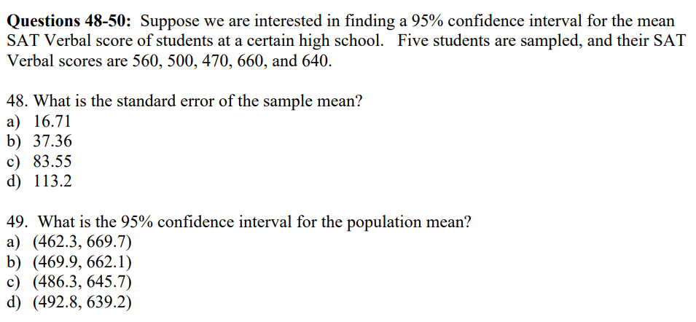
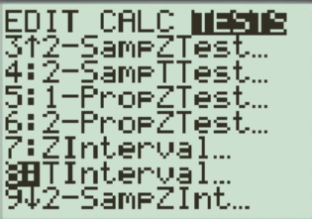
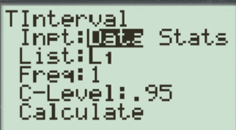
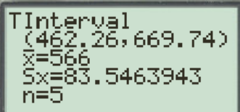
1`
This is a question that uses a T-distribution
b/c the population std deviation is NOT given!
Sample size = 5
Confid Lvl = 95%
Deg Frdm = 4
If you are going to use Data, make sure
that the data is stored in one of the lists
Sample std is 83.546
Std error is equal to:

Slide 9
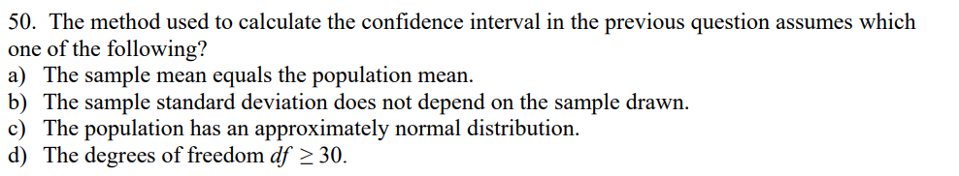

Slide 10
What is a T-distribution??
The “t” distribution is a replacement for the normal distribution (z-distribution) when “population standard deviation” σ is unknown
The t-distribution depends on the level of confidence and the degrees of freedom (df) or “k”
Note: The notations: and represent a t-distribution with “k’ degrees of freedom
A t-distribution is used to estimate the probabilities of your sampling distribution when the pop. std dev. is unknown
A t-distribution is also symmetrical, bell shaped, centered at “zero” , but the areas of the tail has a larger area than a normal distribution
When the sample size ‘n’ gets larger, the (df) gets bigger too, and the t-distribution will look more like a normal distribution
Make sure to check the conditions required for your sampling distribution to be normal
If our sample size is less than 30, check for outliers in our sample.
  If outliers exists in sample → pop. could be skewed, sampling distr. also skewed
  If no outliers→ pop. is normal → sampling distr. also normal

Slide 11
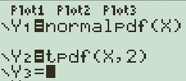
Comparing t-distribution with z-distribution:
Graph the “Z” and “t” distribution on your Ti83
2nd
Distr
1:normalpdf(
OR
4:tpdf(
x
,
df
)
y
This red graph is a
normal distribution
0.4
As the degree of
freedom increases,
the t-distribution
gets closer to a
z-distribution
0.3
0.2
0.1
-2.5
-2
-1.5
-1
-0.5
0
0.5
1
1.5
2
2.5
x

Slide 12
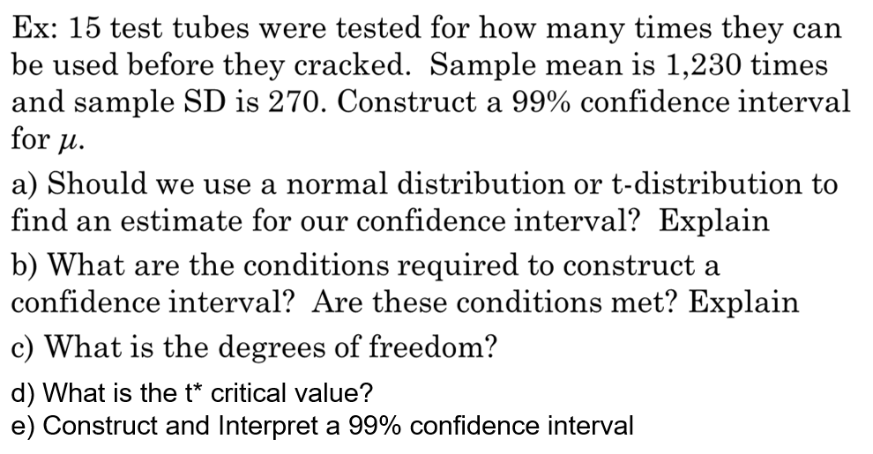

Slide 13
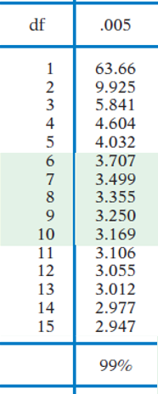
Since we don’t have the population standard deviation,
we need to use a T-distribution and not z-distribution
B) Degrees of Freedom = 15 – 1 = 14 df
c) Find critical T-value for 99% CI with DF= 14
We are 99% confident that the mean the number of times
our tests tubes can be used before cracking is between the
range of 1020 to 1440 times.

Slide 14
10.31 A sample of 21 vehicles from the same model were selected and their fuel efficiency was recorded (mpg).
a) Describe the distribution using graphical methods and summarize the results in a few sentences
b) Is it appropriate to use methods based on Normal Distributions to analyze these data?
c) Find the sample mean, SD, SE and margin of error for a
95% C.I.
d) Construct and interpret a 95% C.I. for µ (the mean mpg for this vehicle based on these data)
e) Do you think that this interval would apply to other smaller vehicles?

Slide 15
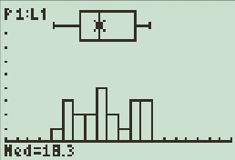
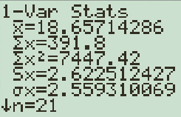
a) This is what the distribution of fuel efficiency for the 21 vehicles look like:
What’s the point of this first step?
From this distribution, we see that
1. There are no outliers – this is evidence towards that the population is not skewed
2. There is no evidence to contradict that the population is not normal:
ie: the box plot is roughly symmetrical.
the distribution of fuel efficiencies of the 21 vehicles are symmetrical about the mean
Since the sample size is less than 30, we need the population distribution needs to be normally distributed in order for the sampling distribution to be normal. Since there are no outliers or skewness in our sample, we can assume that the population is normally distributed. Other conditions are: SRS and independence.
SRS is not mentioned, so we need to assume that the sample was randomly selected. It also reasonable to suggest that every car is independent of one another.

Slide 16
b) Since there are no outliers to suggest that the population is skewed, we would assume that the population distribution is normal. Thus sampling distribution is normal.
Therefore, our sample size does not need to be greater than 30 to perform our T-procedure.
SRS and Independence are also met. Yes is it appropriate to use methods based on Normal distributions to analyze these data
C)
D) 95% Confidence Interval:

Slide 17
Let’s interpret the confidence interval that we found:
Interpretation of confidence interval: We are 95% confident that the mean fuel efficiency (mpg) of this particular car model is between 17.4453 mgp to 19.87mpg.
Now let’s interpret the confidence interval based on the context of this question:
On average, the average fuel efficiency of this vehicle model is between 17.4453 mpg to 19.87 mpg.
D)The distribution of fuel efficiencies of other car models could differ significantly from the vehicle model in this study. Therefore, it is unlikely that the confidence interval from our study would apply to other vehicle models.

Slide 18
From the TEXTBOOK:
“except in the case of small samples, the assumption that the data are an SRS from the population of interest is more important than the assumption that the population distribution is normal
What do we do if the sample size is less than 15?
  We can use the T-procedures if the data from our sample do not have any outliers!
  This is evidence that the population is likely Normal → so sampling distribution is also normal
  If there are outliers in our sample, this indicates population is not Normal, so sampling distribution is not normal. Thus we can NOT use T-procedures for inference
What happens if we have a large sample (30 or more)?
  When the sample size is large (n>30), the sampling distribution will be normally distributed, despite the population distribution
  we can use the T-procedure even if the population distribution is skewed

Slide 19
Paired T-Procedures (Matched Pair
Paired T-Procedures is a procedure for comparing the difference between two related [dependent] groups
You are comparing two sets of measurements where each measurement in one set is directly related to a measurement in the other set
Every data set has two scores, paired together, “before” and “after”
ie: comparing the scores of the same group of students before and after they receive tutoring, where each student's "before" score is directly paired with their "after" score
Comparing patient blood pressure levels before drug treatments and after treatments. All results are paired together
Since the two data sets are NOT independent, we need to pair them, find the difference of each pair, and then use the data set on the differences as one single set of data for our inference procedure

Slide 20
Paired t-procedures (Comparing two means from dependent Samples)
Used for comparing the mean differences between two sets of data that are dependent
  Comparing the effects/response of 2 treatments in a matched pair design
  Comparing the response to 2 treatments from individuals receiving both treatments
  Comparing the before-after measurements on individuals
Conditions for sampling distribution to be normal:
  SRS – The data are an SRS from the population of interest
  Normality – the population of interest has a normal distribution OR sample size must be larger than 30 if the population is not normally distributed
  Independence – Each individual pairs of observations are independent of another individual data set
Condition for standard error formula
  The population size must be 10 times or more than the sample size

Slide 21
Does the moon influence aggressive actions? A study of 15 dementia patients in nursing homes recorded various types of disruptive behaviours every day for 12 days. Moon days are in a 3 day period centered at the day of full moon. Average number of aggressive behaviours are averaged between “moon days” vs “Other days”
a) Set L1 and L2 as the number of aggressive incidence for “moon days” and “other days”. Then set L3 as the difference in aggressive incidence between L1 and L2
b) Find the mean and standard deviation from L3. Interpret the mean and standard deviation
c) Construct and interpret a 95% C.I. for the mean difference in aggression behaviours on moon days and other days among dementia patients
d) Can we conclude that the moon is causing dementia patients to become more aggressive? Why or why not?

Slide 22
a) The first step of performing a Matched Pair T-test is to create a random variable, say “D”. Then define your random variable “D” as:
“D” = Number of disruptive --- Number of disruptive
behaviors on moon days behaviours on NON-moon days
Next, enter the values in L1 and L2, make L3 = L1 – L2, where “L3” is the difference between the two list.
Do a 1Var stats test L3 to find the mean difference and SD.
The average difference in the number of disruptive behaviours between Full Moon vs Non Full Moon days from our sample is 2.432 incidence, with a sample standard deviation of 1.46032.
There is an increase of 2.432 incidence on full moon days than non-full moon days.

Slide 23
C) To construct a confidence interval, we can use the formula or the Ti83. Suppose we want to use the formula, then find the critical value t* for a 95% CI for the mean difference
We are 95% confident that the mean difference in aggressive incidents among dementia patients during full moon days vs non full moon days is between 1.6239 to 3.2414 incidents.
Interpretation in context: On average, dementia patient have 1.6239 to 3.2414 more disruptive behaviors during full moon days vs non full moon days.
Side Note: Notice that our confidence interval does contain a mean of zero. This is evidence against the position that there is no difference in behavior on full moon days and non-full moon days.

Slide 24
D) Can we ESTABLISH CAUSATION???
First off, is this an experiment or study?
This is a study, no treatment was given
Second: There is no control group for assurance that all other variables are consistent other than full moon OR non full moon. For instance, many factors can affect the well being of elderly patients. Ie: number of nurses/health care aids that are working, or amount of sedation given to patients. These variables may not be consistent.
NOW suppose these other factors were consistent, could there still be a lurking variable or confounding variable? A brighter full moon made it difficult for patients to sleep. So if patients were unable to sleep, they became more agitated, and thus more aggressive incidents.
There have been studies suggesting that full moons increased crime. Yet, these studies were inconclusive. Another suggestion is that full moons may change atmospheric pressures that affect our bodies.
https://hellocare.com.au/twilight-zone-moon-affect-people-dementia/

Slide 25
L3 = L1 – L2 vs L1 and L2
When performing a matched pair T-test, which method is more appropriate for finding a confidence interval?
Method 1: Find the difference of each observation and inputting the values into L3
Method 2: Find the mean and standard deviation of L1 and L2 separately. Then use the random variables formula to find the difference in mean and standard deviation:
Which method is more suitable for a matched pair T-test?
Since the observations are matched in pairs, they are NOT independent. We would need to perform our inference procedures as ONE data set in L3 to find our Confidence interval
If the two sets of data were Independent, find the mean and std deviation of each set separately. We can perform our inference procedures as TWO data sets.
Then create a 3rd random variable as the difference of two variables. Then use our equations for adding/subtracting random variables (ch7) to find the mean, std dev., and variance of our 3rd variable.

Slide 26
Ex: A researcher is investigating the effectiveness of a new memory enhancement technique. They recruit 30 participants and administer a memory test to each participant. After the initial test, the participants undergo a memory training program for one month. After completing the program, the participants are tested again using the same memory test to see if there is any improvement.
The scores of the participants before and after the memory training program are paired, with each participant serving as their own control. The researcher wants to calculate a 95% confidence interval for the mean difference in test scores before and after the program to estimate the range in which the true mean difference in memory scores might lie.
a) Check if all the conditions for inference procedures are met
b) Create a 98% confidence interval
c) Interpret this C.I. in context, is there evidence to suggest that the program is improving memory? Explain

Slide 27
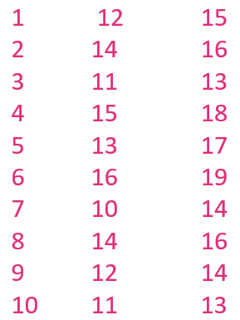
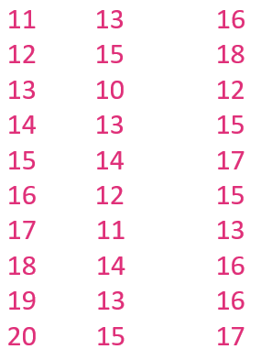
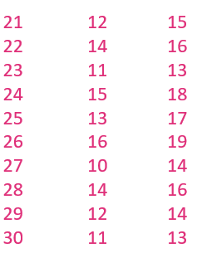
Before Training
After Training
Before Training
After Training
Before Training
After Training
Patient
Patient
Patient

